Slide 1
Solutions and Colloidal Dispersions
Chapter 20

Slide 2
Solutions and Colloidal Dispersions
Objectives
Vocabulary
Describes the properties of solutions
Describe the properties of colloidal dispersions
Identify and describe three types of colloidal dispersions
Use examples to explain how solutions and colloidal dispersions exist as foods
Unsaturated
Saturated
Solubility
Colloidal dispersions
Aggregate
Dispersed phase
Continuous phase
Emulsions
Temporary emulsion
Homogenization
Osmosis

Slide 3
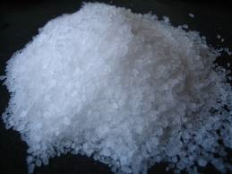
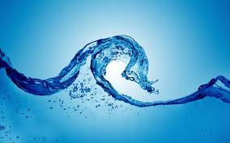
Solutions
Solutions: Crash Course Chemistry #27 (8:21)
http://www.youtube.com/watch?v=9h2f1Bjr0p4
Solutions are homogenous mixtures of at least two substances, a solute that dissolves in a solvent.
Solutes can be solids liquids and gases EX: salt
Solvents can be solids liquids and gases but it is usually a liquid like water.

Slide 4
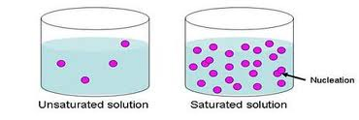
Solutions
Saturated, Unsaturated, and Superstaurated Solutions (10:20)
http://www.youtube.com/watch?v=QeNn3sY1bu4
Unsaturated- as long as the solution contains less solute it can be dissolved at a given temperature
Saturated- solution that contains all the solute given at a given temperature

Slide 5
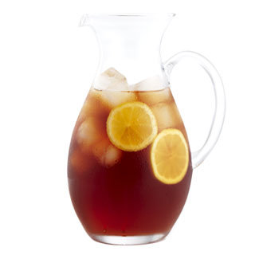
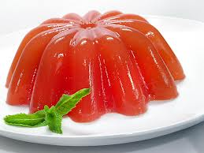
Solubility
Solubility – describes the maximum amount of solute that can be dissolved in a definite amount of solvent at a specific temperature
Temperature effects solubility
Mixtures that are heated can dissolve more than mixture at a cooler temperature

Slide 6
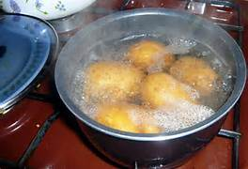
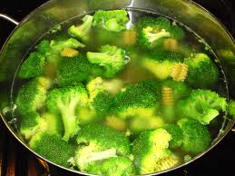
Vitamins and Minerals in Solutions
Surface area – the greater the surface area is exposed to the solution the greater the vitamin and mineral loss.

Slide 7
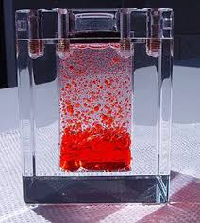
Colloidal dispersions
Colloidal Dispersions – particles of one substance are distributed, or dispersed, in another substance without dissolving.
Aggregate – a group or dense cluster of ions or molecules
B12 molecules form aggregates in a colloidal dispersion

Slide 8
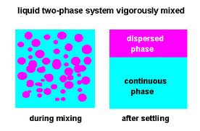
Two Phases of Colloidal dispersions
Dispersed phase- substance that is dispersed within another
Continuous phase- substance that extends throughout the system and surrounds the dispersed phase

Slide 9
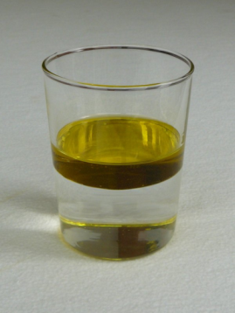
Emulsion
Emulsions are one type of colloidal dispersion
Emulsions – a mixture of two liquids that normally don’t blend with one another
Since the two liquids cant combine they are said to be immiscible
The two basic types of emulsion is oil and water.
What is an emulsion (3:07)
http://www.youtube.com/watch?v=bC_czAL24zY

Slide 10
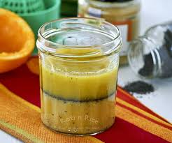
Emulsion
Temporary emulsion – you can get two liquids to mix by stirring (but it will only stay mixed for a little while)

Slide 11
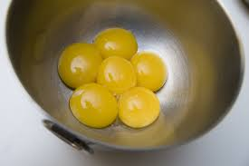
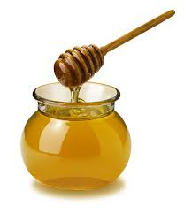
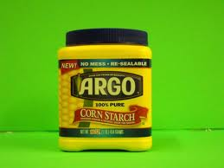
Emulsion
Permanent Emulsions – by adding an emulsifier to a mixture can keep one liquid permanently dispersed.
Emulsifiers – substances that can be used to hold emulsions together.

Slide 12
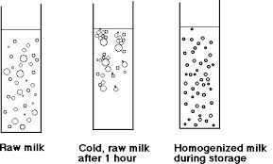
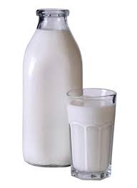
Homogenization
Homogenization – fat globules are reduced to a smaller, more equal, size and distributed evenly

Slide 13
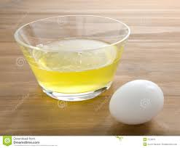
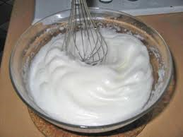
Food foams
Foams are another type of colloidal dispersion
These dispersions of gas in liquid are actually very complex colloidal dispersions

Slide 14
Colloidal Dispersions
Solutions
Particles don’t dissolve
Dispersed phase
Continuous phase
Temporary emulsions
Permanent emulsions need emulsifiers
Ex. Whipped cream, mayo, milk
Particles dissolve
Unsaturated
Saturated
Ex. Sugar in Iced tea

Slide 15
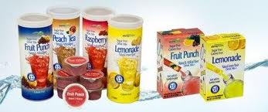
Food separation techniques
Food scientist need to know this to sell powdered products to consumers.
Distillation is a method of separating a mixture by heating it up

